Slide 1
Case 3 Initial Results, Analysis & Recommendations

Slide 2
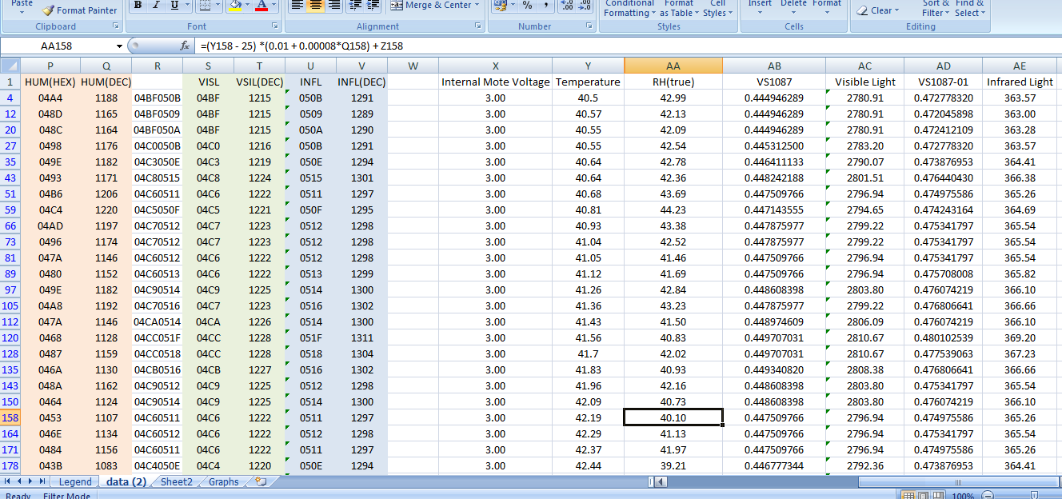
Raw data

Slide 3
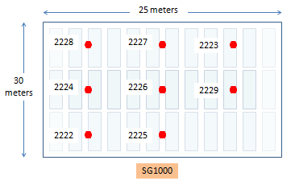
Temp. & RH for 0943-1043 AM July 21, 2014
For this hour, the maximum temperature
was recorded by node 2228 at 51.32 °C
and corresponding relative humidity was at 29.75% at 9:48 AM.
However, the last known transmission of node 2228
was recorded at 10:14 AM at a distance of 32.5 meters.

Slide 4
Temp. & RH for 1051-1151 AM July 21, 2014
For this hour, the maximum temperature
was recorded by node 2224 at 57.03 °C
and corresponding relative humidity was at 22.05% at 11:14 AM.
Nodes 2227 (30 meters), 2222 (12.5 meters) and 2223 (32.5 meters) had limited transmissions within this hour.

Slide 5
Temp. & RH for 1203-1303 PM July 21, 2014
For this hour, the maximum temperature
was again recorded by node 2224 at 53.82 °C
and corresponding relative humidity was at 25.90% at exactly 12:23 PM.
Nodes 2227 (30 meters), 2222 (12.5 meters) and 2223 (32.5 meters) also had limited transmissions within this hour.

Slide 6
Temp. & RH for 1304-1404 AM July 21, 2014
For this hour, the maximum temperature
was recorded by node 2226 at 55.4 °C
and corresponding relative humidity was at 23.90% at exactly 1:36 PM.
Nodes 2227 (30 meters), 2222 (12.5 meters) and 2223 (32.5 meters) also had limited transmissions within this hour.

Slide 7
Temp. & RH for 0943-1043 AM July 21, 2014
For this 4 hour initial test, the maximum temperatures were recorded by nodes 2224 and 2226 at 57.03 °C and 55.4 °C respectively. However, nodes 2227 (30 meters), 2222 (12.5 meters) and 2223 (32.5 meters) also had limited transmissions and even node 2228 was cut off after an hour, so gathered data was not representative given that not all nodes transmit for the whole duration.

Slide 8
Node Coverage
MAXIMUM TEMPERATURE
meters
 | 5 | 10 | 15 | 20 | 25
5 | 51.32 | 51.32 | 53.35 | 53.35 | 51.17
10 | 51.32 | 51.32 | 53.35 | 53.35 | 51.17
15 | 57.03 | 57.03 | 55.4 | 55.4 | 51.17
20 | 57.03 | 57.03 | 55.4 | 55.4 | 51.75
25 | 52.6 | 52.6 | 50.73 | 50.73 | 51.75
30 | 52.6 | 52.6 | 50.73 | 50.73 | 51.75
 | Meters
Meters | 5 | 10 | 15 | 20 | 25
5 | 2228 | 2228 | 2227 | 2227 | 2223
10 | 2228 | 2228 | 2227 | 2227 | 2223
15 | 2224 | 2224 | 2226 | 2226 | 2223
20 | 2224 | 2224 | 2226 | 2226 | 2229
25 | 2222 | 2222 | 2225 | 2225 | 2229
30 | 2222 | 2222 | 2225 | 2225 | 2229
This table represents the maximum temperature taken by the nodes operating within an area of the dryer. Looking at the table, a swing of 7 °C from the left side to my location is not acceptable because the aim is to have a uniform temperature across the entire drying area.

Slide 9
This plot represents the maximum temperature taken by the nodes operating within an area of the dryer. Looking at the plot, a swing of 7 °C (orange) from the left side to my location (green) is not acceptable because the aim is to have a uniform temperature across the entire drying area which should indicate ideally the same color.

Slide 10
Node Coverage
MINIMUM TEMPERATURE
meters
 | 5 | 10 | 15 | 20 | 25
5 | 45.29 | 45.29 | 46.19 | 46.19 | 41.84
10 | 45.29 | 45.29 | 46.19 | 46.19 | 41.84
15 | 41.74 | 41.74 | 42.06 | 42.06 | 41.84
20 | 41.74 | 41.74 | 42.06 | 42.06 | 40.55
25 | 40.21 | 40.21 | 38.33 | 38.33 | 40.55
30 | 40.21 | 40.21 | 38.33 | 38.33 | 40.55
 | Meters
Meters | 5 | 10 | 15 | 20 | 25
5 | 2228 | 2228 | 2227 | 2227 | 2223
10 | 2228 | 2228 | 2227 | 2227 | 2223
15 | 2224 | 2224 | 2226 | 2226 | 2223
20 | 2224 | 2224 | 2226 | 2226 | 2229
25 | 2222 | 2222 | 2225 | 2225 | 2229
30 | 2222 | 2222 | 2225 | 2225 | 2229
This table represents the minimum temperature taken by the nodes operating within an area of the dryer. Looking at the table, a swing of 8 °C from the back to my location is not acceptable because the aim is to have a uniform temperature across the entire drying area.

Slide 11
This plot represents the minimum temperature taken by the nodes operating within an area of the dryer. Looking at the plot, a swing of 8 °C (green) from back to my location (blue) is not acceptable because the aim is to have a uniform temperature across the entire drying area which should indicate ideally the same color.

Slide 12
Node Coverage
MINIMUM RH
meters
 | 5 | 10 | 15 | 20 | 25
5 | 29.75 | 29.75 | 26.84 | 26.84 | 29.69
10 | 29.75 | 29.75 | 26.84 | 26.84 | 29.69
15 | 21.92 | 21.92 | 23.9 | 23.9 | 29.69
20 | 21.92 | 21.92 | 23.9 | 23.9 | 28.7
25 | 26.3 | 26.3 | 28.28 | 28.28 | 28.7
30 | 26.3 | 26.3 | 28.28 | 28.28 | 28.7
 | Meters
Meters | 5 | 10 | 15 | 20 | 25
5 | 2228 | 2228 | 2227 | 2227 | 2223
10 | 2228 | 2228 | 2227 | 2227 | 2223
15 | 2224 | 2224 | 2226 | 2226 | 2223
20 | 2224 | 2224 | 2226 | 2226 | 2229
25 | 2222 | 2222 | 2225 | 2225 | 2229
30 | 2222 | 2222 | 2225 | 2225 | 2229
This table represents the minimum RH taken by the nodes operating within an area of the dryer. Looking at the table, a swing of 7% from the left side to my location is not acceptable because the aim is to have a uniform RH across the entire drying area. Far back is even more humid considering these nodes are only 5 meters apart.

Slide 13
This plot represents the minimum RH taken by the nodes operating within an area of the dryer. Looking at the table, a swing of 7% from the left side to my location is not acceptable because the aim is to have a uniform RH across the entire drying area. Far back is even more humid considering these nodes are only 5 meters apart.

Slide 14
Node Coverage
MAXIMUM RH
meters
 | 5 | 10 | 15 | 20 | 25
5 | 40.37 | 40.37 | 39.96 | 39.96 | 44.86
10 | 40.37 | 40.37 | 39.96 | 39.96 | 44.86
15 | 43.41 | 43.41 | 47.04 | 47.04 | 44.86
20 | 43.41 | 43.41 | 47.04 | 47.04 | 47.96
25 | 46.86 | 46.86 | 51.94 | 51.94 | 47.96
30 | 46.86 | 46.86 | 51.94 | 51.94 | 47.96
 | Meters
Meters | 5 | 10 | 15 | 20 | 25
5 | 2228 | 2228 | 2227 | 2227 | 2223
10 | 2228 | 2228 | 2227 | 2227 | 2223
15 | 2224 | 2224 | 2226 | 2226 | 2223
20 | 2224 | 2224 | 2226 | 2226 | 2229
25 | 2222 | 2222 | 2225 | 2225 | 2229
30 | 2222 | 2222 | 2225 | 2225 | 2229
This table represents the maximum RH taken by the nodes operating within an area of the dryer. Looking at the table, a swing of 11% from the farthest back to my location is not acceptable because the aim is to have a uniform RH across the entire drying area.

Slide 15
This table represents the maximum RH taken by the nodes operating within an area of the dryer. Looking at the table, a swing of 11% from the farthest back to my location is not acceptable because the aim is to have a uniform RH across the entire drying area.

Slide 16
Recommendations:
There will be a long haul monitoring on the same nodes.
At same node height and position for 7 days.
At mid-height but same position for another 7 days.
The Advanticsys SG100 will be moved opposite the existing area.
At same node height and position for 7 days.
At mid-height but same position for another 7 days.
The nodes will be enclosed in a waterproof casing.
The Advanticsys SG1000 will be located atop the area and enclosed in an acrylic casing.
Further analysis of the results will be conducted after all monitoring have been done.

